Slide 1
Buzzduino GUI instructions
(vibe_GUI_1motor_simple.zip)

Slide 2
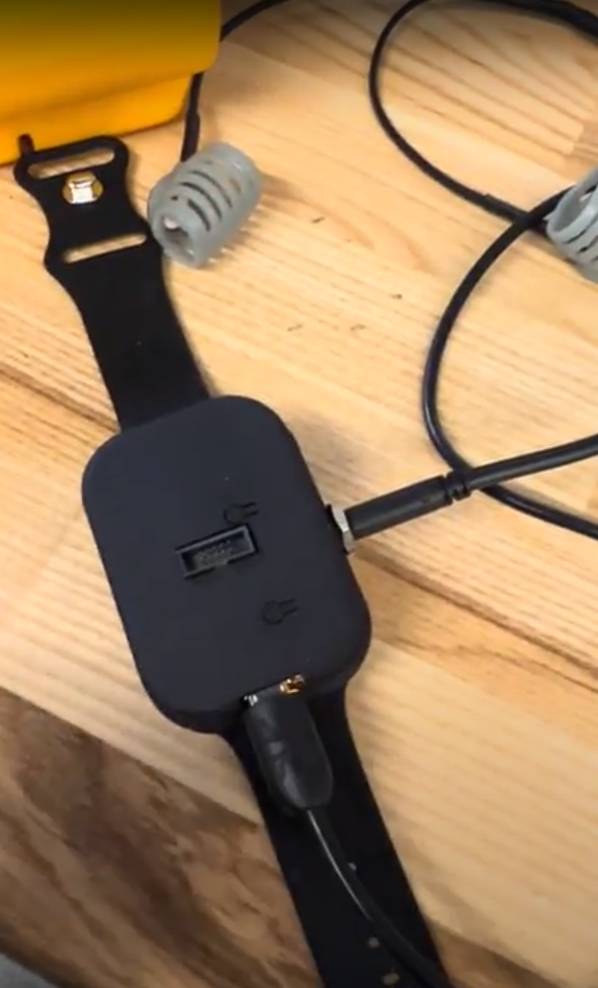
Device Overview
Cycles rainbow leds when not connected to BLE.
White led when connected to BLE
Pressing this button will replay the last vibration command send to the device. For PWM driving it will toggle at the last amp/freq selected. For Effect Sequencing it will play once. Called the “Buzz Button”
On/Off button. Press and hold for 5 sec to turn off. Single press to turn on.

Slide 3
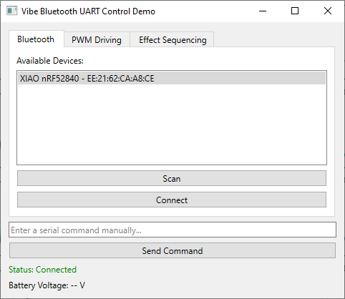
GUI-Bluetooth connection
Click ‘Scan’ Button to look for devices. Only shows devices with BLE UART service.
Select the one that mentions the ‘nRF52840’
Click ‘Connect’
Verify Connection ‘Status: Connected’

Slide 4
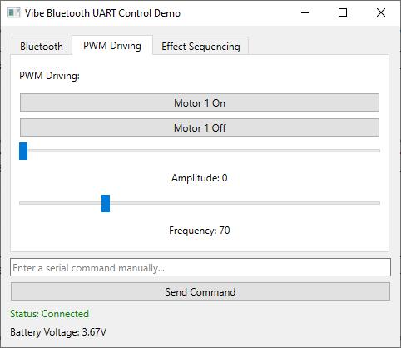
GUI – PWM Driving
This is the primary mode of operation for demonstration.
Sliders adjust frequency and amplitude of vibration.
Note that the reasonant frequency of the LRA actuators is 170Hz, so that is the recommended frequency to use.
Motor 1 On/Off button to toggle motors
After setting amplitude/frequency and toggle motor once. That same setting will be used if the buzz button is pressed on the device.

Slide 5
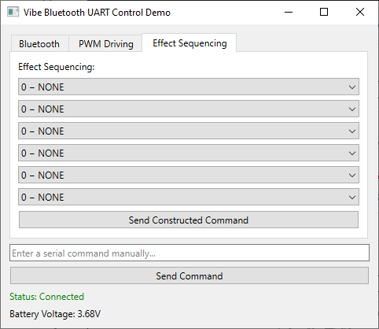
GUI – Effect Sequencing
Effect sequencing has not been optimized. Demos haptic driver built in effects and sequencing.
Any combination of canned effects can be selected in drop down lists.
Click ‘Send Constructed Command’ and will switch modes on haptic driver and effects will play 1 time.
Pressing the buzz button of the device will play the effect sequence.
*Note that effects are short in duration. Additionally, the vibration strength for effects if not very strong for the current prototype.

